Slide 1
Introduction to Cybersecurity
Module 1

Slide 2
Learning Outcomes
Understand what cybersecurity is and its importance
Understand the lessons learned from historical/current events
Understand the various assets cyber professionals are protecting
Describe the principles of cybersecurity

Slide 3
What is cybersecurity?
What comes to your mind when you think of cybersecurity?

Slide 4
What is cybersecurity?
Cybersecurity is the art of protecting networks, devices, and data from unauthorized access or criminal use and the practice of ensuring confidentiality, integrity, and availability of information. - (CISA, 2021)
CISA = Cybersecurity and Infrastructure Security Agency
Networks include: wired and wireless networks
Devices include: laptops, workstations, cellphones, smart watches, medical devices, cars, fridges, garage doors, card readers, tablets, etc.
Really anything that can connect to a network!
Data can include: PII (Personally Identifiable Information), financial, medical, location, shopping habits, social media profiles, contracts, etc.
https://www.cisa.gov/news-events/news/what-cybersecurity

Slide 5
What does cybersecurity include?
Which majors should learn about cybersecurity? Why?

Slide 6
What does cybersecurity include?
Cybersecurity is often described as an interdisciplinary or multidisciplinary field because it borrows from many fields like:
Computer Science
Information Technology
Psychology
Military Science
Project Management
Sociology
And many others

Slide 7
Where did cybersecurity come from?
1960s
1970s
1980s
1990s
Physically Secure Cyber Assets
“Lock the door behind you”
Networks need to be secured as well
ARPANET, the first public packet switched network, was launched in 1969
Cyber Attacks can be launched against key infrastructure
Prompted the Computer Security Act of 1987
Cyber Attacks can be launched against anything or anyone that is connected to the internet.
Presidential Decision Directive 63 in 1998
Notes:
The Presidential Decision Directive 63: Outlines the increased reliance on cyber infrastructure by public and private enterprises, and the strong need for collaboration to improve the security of this infrastructure. 1st for the White House

Slide 8
Where did cybersecurity come from?
Emerging Threats
Artificial Intelligence
Software Supply Chain Attacks
Lack of cybersecurity professionals: https://www.cyberseek.org/heatmap.html
State-sponsored cyber warfare
2000s
2010s
2020s-Current
Data shared on the internet was a target
Large data breaches began to affect millions
Ransomware can bring critical infrastructure to a halt
Data breaches and ransomware continued to be an issue
2011 Sony is affected by a breach of 77 million users PII
CISA was created in 2018

Slide 9
What are we protecting?
Identity
Devices
Data
Critical Infrastructure

Slide 10
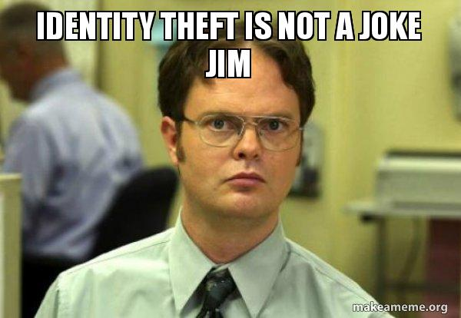

Slide 11
Identity
The process by which intruders steal someone’s personal information and use it or sell it without consent is called “Identity Theft”
Personally Identifiable Information (PII)
“Any information that can be used to distinguish or trace an individual’s identity, such as name, social security number, date and place of birth, mother’s maiden name” - NIST SP 800-122
How can someone take advantage of your identity?

Slide 12
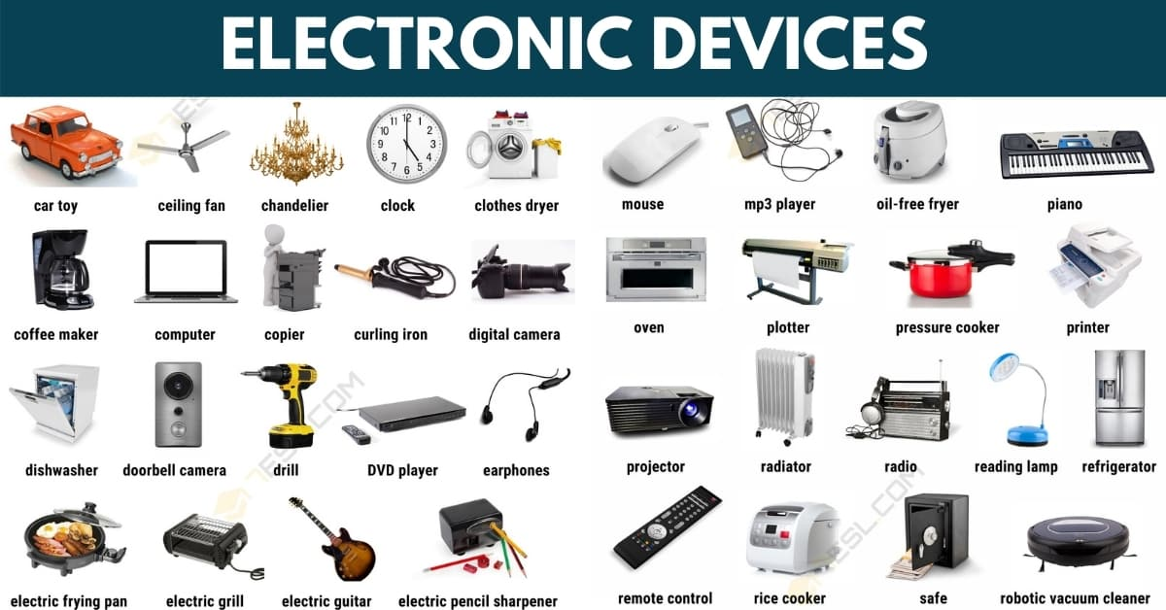
Devices
Devices: Computing and network resources
Computers
Mobile Devices
IoT Devices
Smart anything
Cameras
Switches
Routers
RFID Tokens
What could happen if someone steals a device?
https://7esl.com/electronic-devices/

Slide 13
Data
There are 3 states that we must protect data in:
Data at Rest: Data that is stored in media
Data in Transit: Data transmitted from one location to another
Data in Use: Data that is loaded in computer memory for processing

Slide 14
Critical Infrastructure
Chemical Sector
Communications Sector
Commercial Facilities Sector
Critical Manufacturing Sector
Dams Sector
Defense Industrial Base Sector
Emergency Services Sector
Energy Sector
Financial Services Sector
Food and Agriculture Sector
Government Facilities Sector
Healthcare and Public Health Sector
Information Technology Sector
Nuclear Reactors, Materials, and Waste Sector
Transportation Sector
Water and Wastewater Systems Sector
https://www.dhs.gov/cisa/critical-infrastructure-sectors

Slide 15
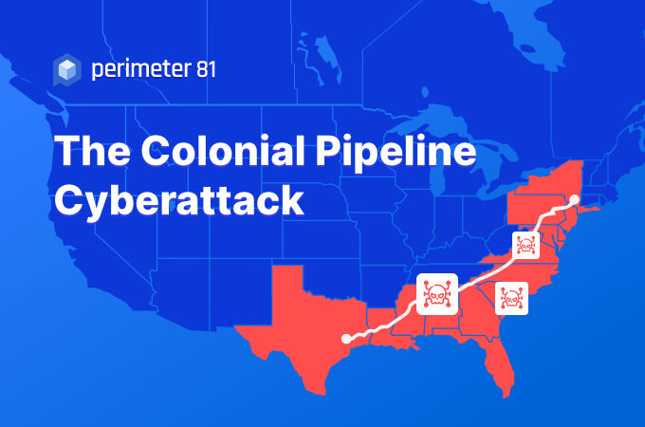
Recent Cyber Attack on Critical Infrastructure
On May 6, 2021 the Colonial Pipeline, the largest oil pipeline in the U.S. spanning more than 5,500 miles, was the victim of a ransomware attack.
On May 9, 2021 President Biden declared a state of emergency
Airlines were greatly affected and panic-buying of gasoline caused gas shortages in FL, GA, AL, VA, and the Carolinas
Paid $4.4 million in ransom

Slide 16
How can organizations look at cybersecurity?

Slide 17

Cybersecurity Principles
Think like
an Adversary
Availability
Integrity
Confidentiality
Defense
in Depth
Keep it Simple

Slide 18
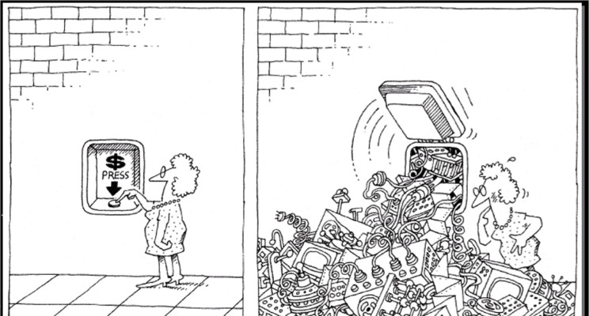
Keep it simple (KISS)
“Complexity is the worst enemy of security, and our systems are getting more complex all the time.” - Bruce Schneier

Slide 19
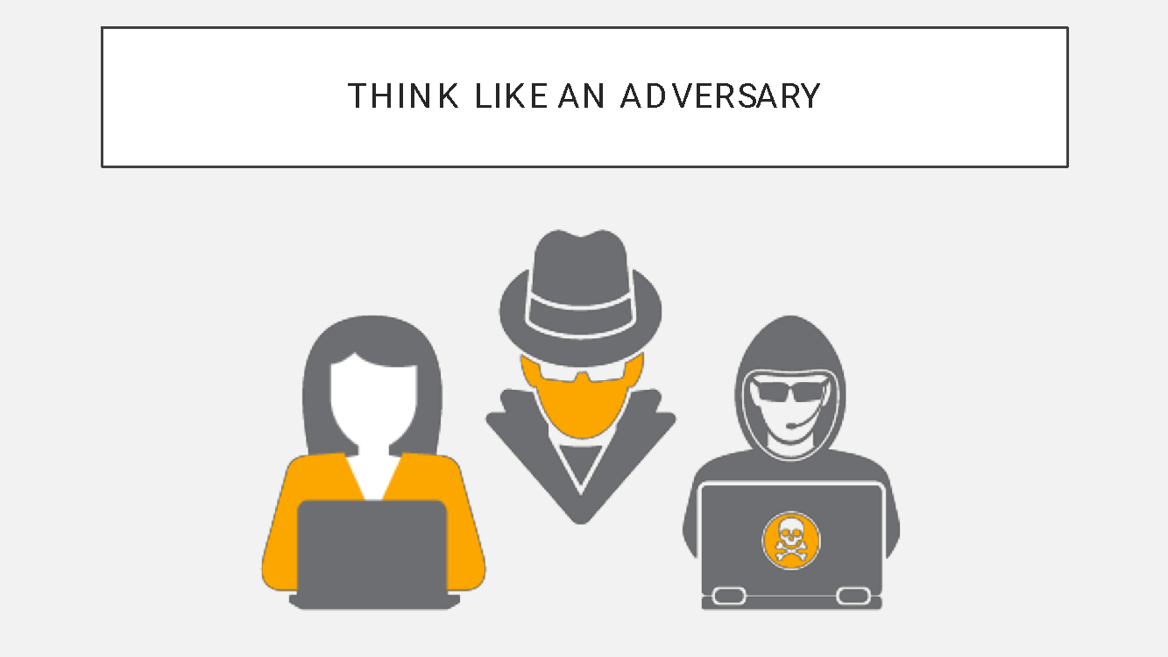

Slide 20
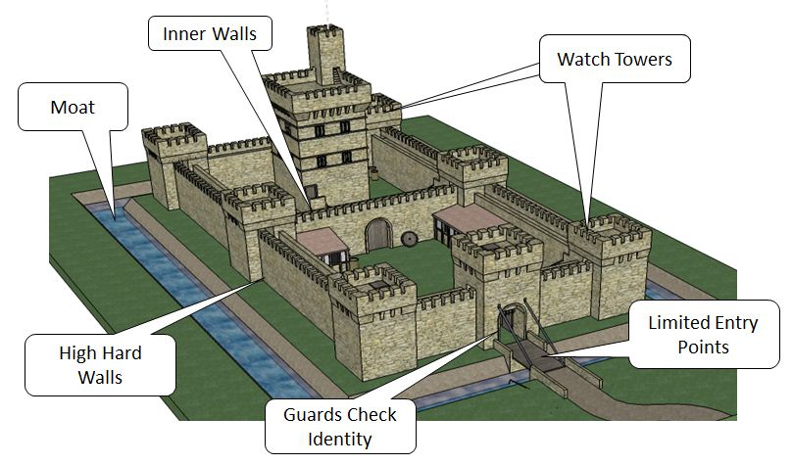
Defense in Depth

Slide 21
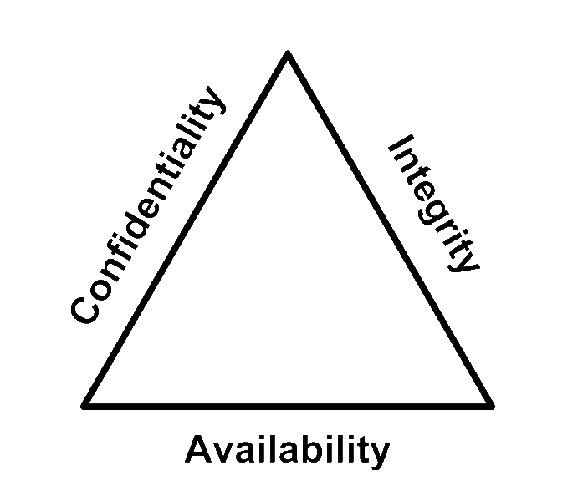
Confidentiality, Integrity, Availability (The CIA Triad)
The CIA Triad is used by cyber professionals to implement security practices:
Confidentiality
Integrity
Availability

Slide 22
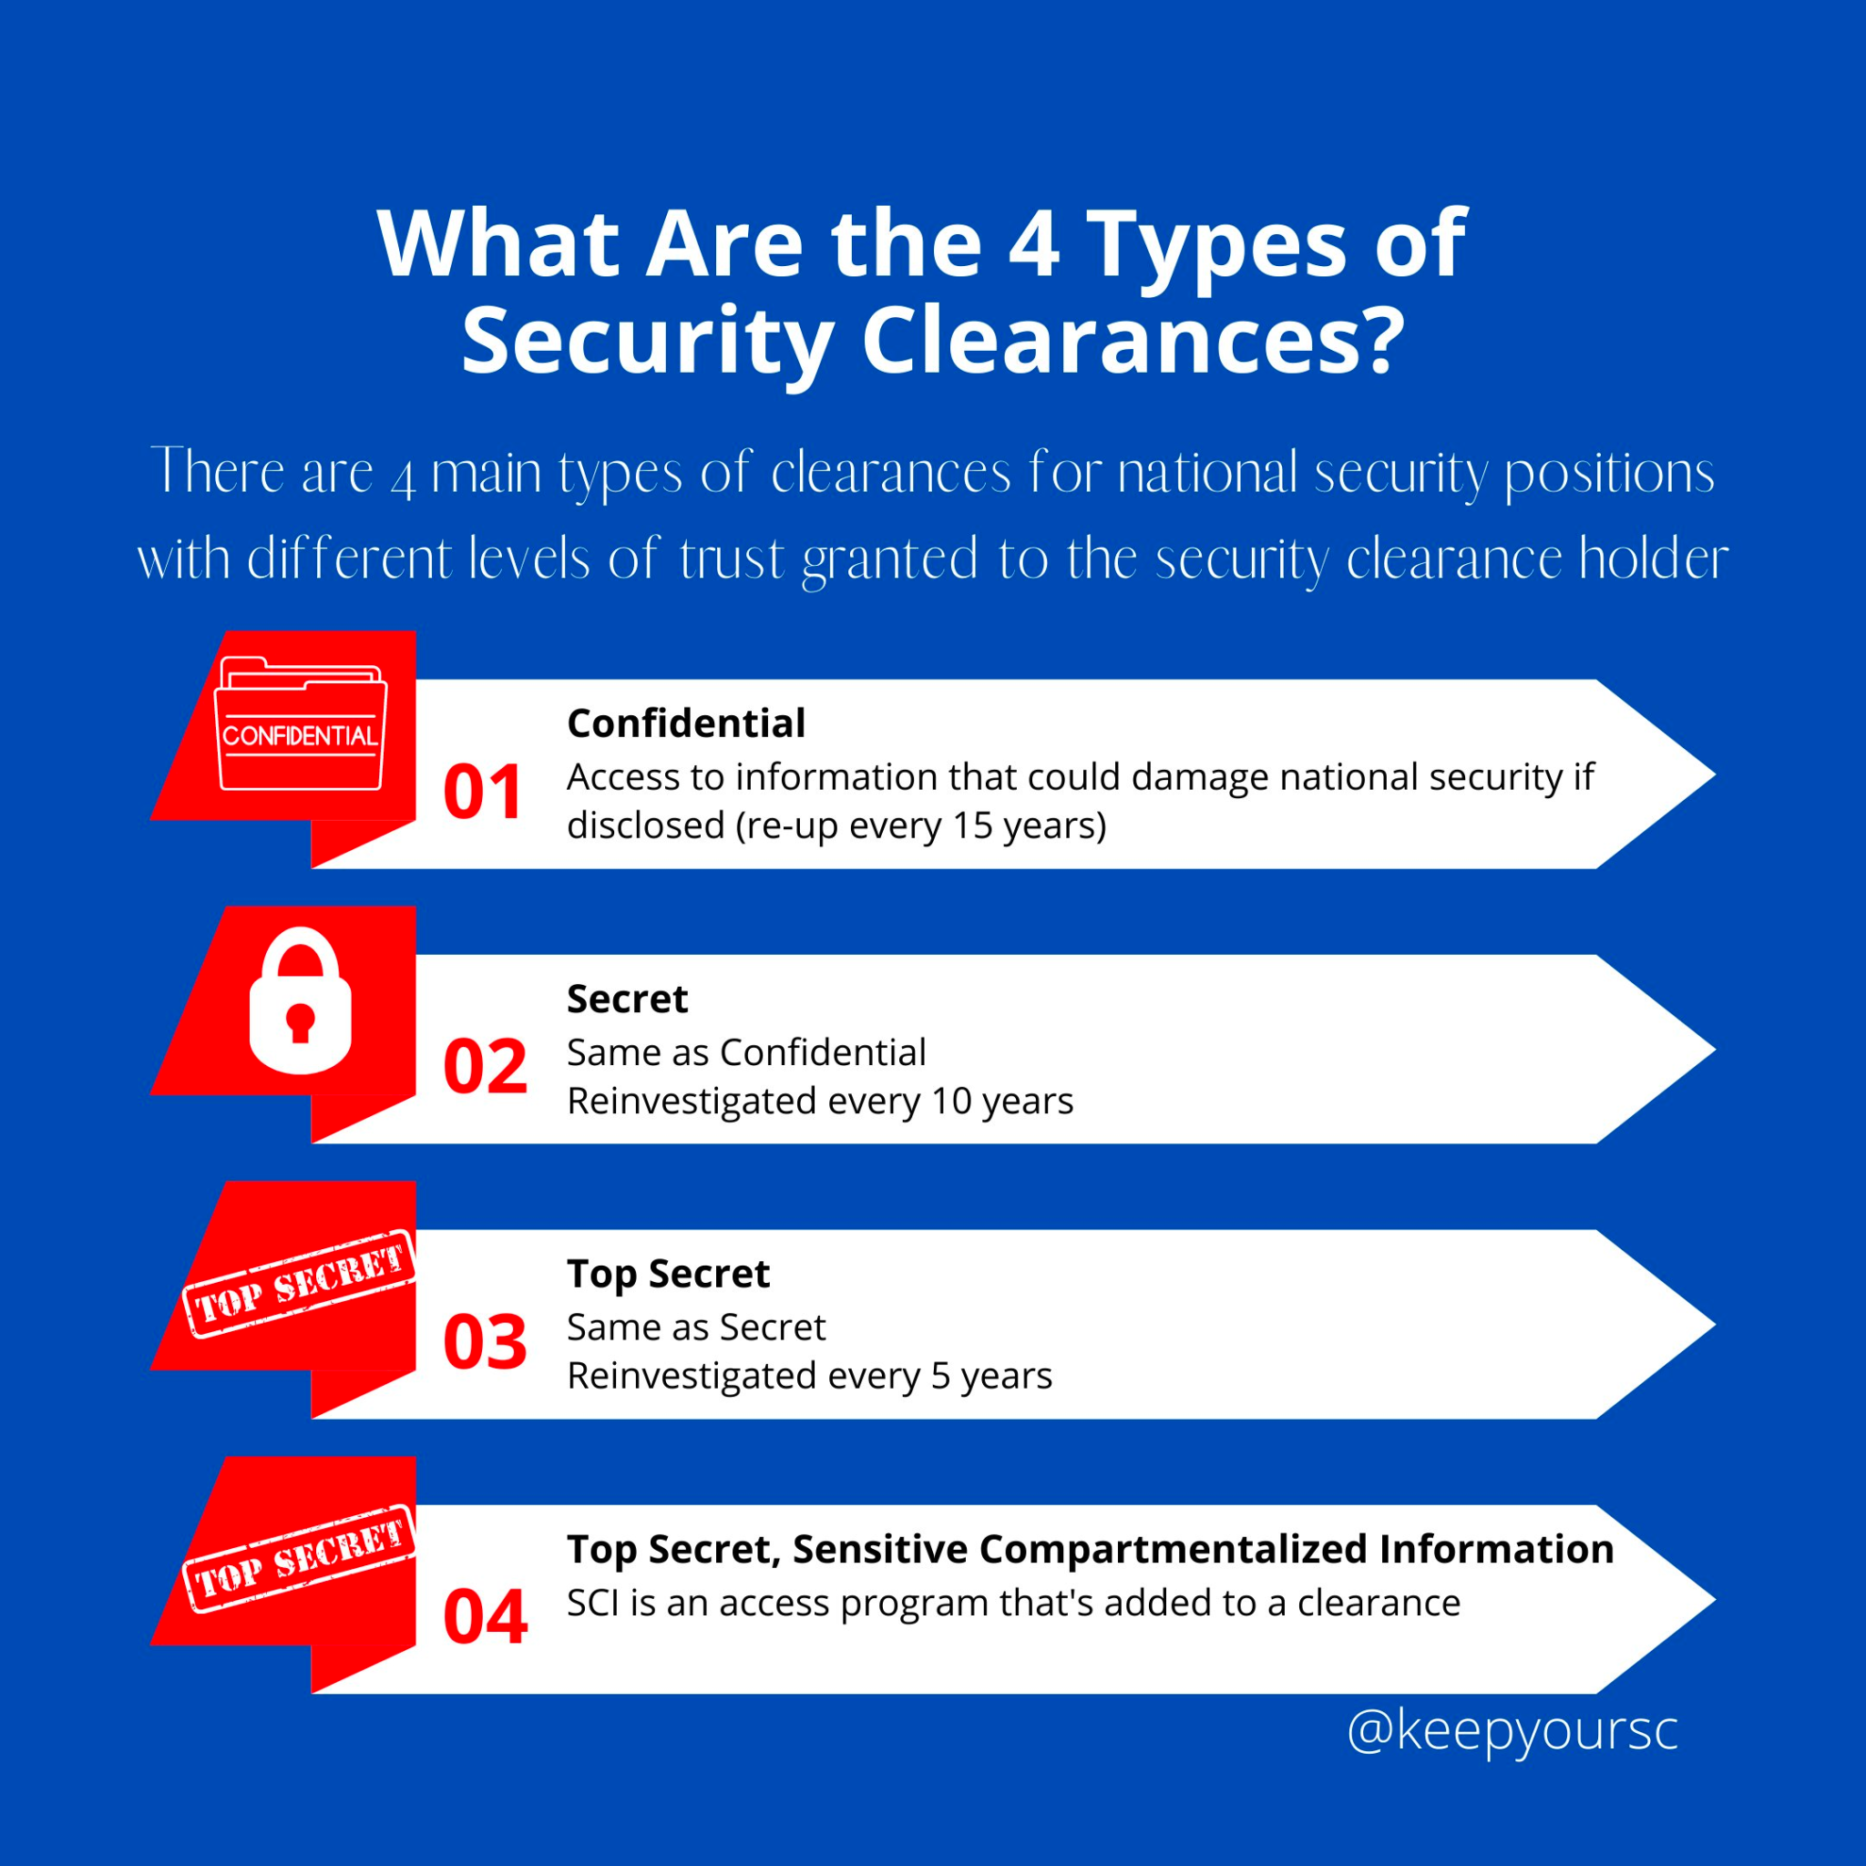
Confidentiality
The assurance that unauthorized personnel do not obtain access to private information and that legitimate users don’t access information they are not authorized to access
How do we protect the confidentiality of data? (Hint →)

Slide 23
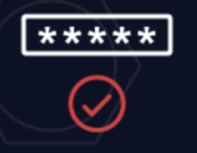
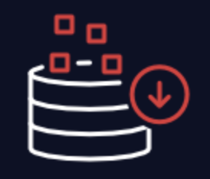

Integrity
The assurance that data may be modified only through an authorized mechanism
Unauthorized users altering data
Authorized users making unauthorized changes to data
Data being altered through an unauthorized mechanism
How do we protect the integrity of data?
Notes:
Auditing
Access Control Mechanisms
Input Validation
backups

Slide 24
Availability
The ability of authorized users to access an organization’s data for legitimate purposes
Information is not helpful if it can’t be accessed!
What could affect the availability of information for an organization?

Slide 25
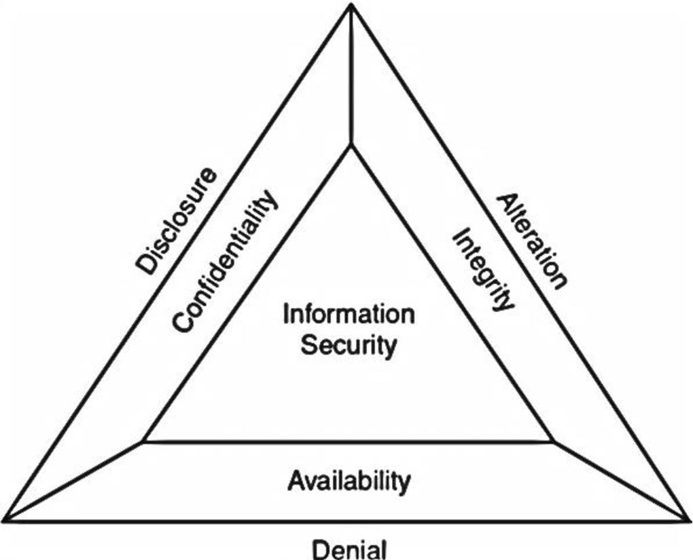
Disclosure, Alteration, Denial (The DAD Triad)
The DAD Triad outline the 3 primary mechanisms used against an organization's information security
Disclosure
Occurs when unauthorized individuals gain access to confidential information
Alteration
When integrity of data is compromised
Denial
Prevents authorized users from accessing a system

Slide 26
Let’s “Think like an Adversary” for a second …
Identify what part of the DAD Triad each statement most aligns to:
If you were to get into the class registration system and remove all students from CIS 377
Alteration
If you publish the formula for Coca-Cola on Reddit
Disclosure
If you were to flood a network with so many requests it is unable to handle regular traffic
Denial

Slide 27
What are we going to learn in this class?
Cybersecurity Careers
Legal, Ethics, and Cyber War
Network/Network Security
Cyber Attacks/Defenses
Identity, Authentication & Access Control
Social Engineering
Cryptography
Software Security and Software Supply Chain
Risk Management
Digital Forensics
Incident Response

Slide 28
Add to your Alphabet Soup …
CISA - Cybersecurity and Infrastructure Security Agency
PII - Personally Identifiable Information
CIA - Confidentiality, Integrity, Availability
DAD - Disclosure, Alteration, Denial

